Slide 1



Regression Example
Data: Boston Housing (1978)
Source: http://www.cs.toronto.edu/~delve/data/boston/bostonDetail.html

Slide 2
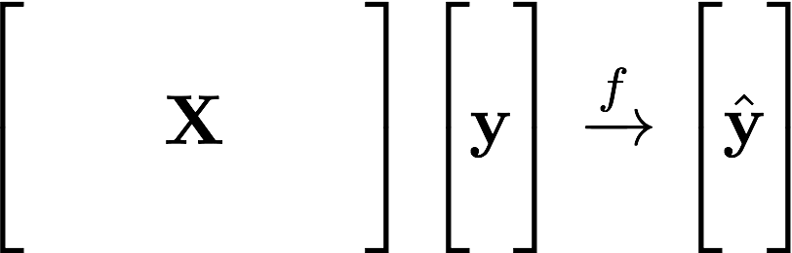
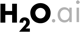
Supervised Learning Example
Machine Learning:
Learn Patterns
from Data
Historical Data:
No. of Rooms
Crime Rate
Pupil-Teacher Ratio
…
Target:
House Value
Predicted Value

Slide 3
Supervised Learning – You Already Have Target Data
Regression:
How much will a customers spend?
Classification:
Will a customer make a purchase? Yes or No
yes
no
y
x_{j}
X
x_{i}
H₂O algos:
Penalized Linear Models
Random Forest
Gradient Boosting
Neural Networks
Stacked Ensembles
H₂O algos:
Penalized Linear Models
Naïve Bayes
Random Forest
Gradient Boosting
Neural Networks
Stacked Ensembles

Slide 4
Regression – Key Steps
Import Data (CSV Files)
./data/regression/ …
Have a quick look
Train a Random Forest Model
Look at variable importance
Make Predictions
Compare with ground truth
Build Partial Dependence Plots
Explain model behaviour

Slide 5
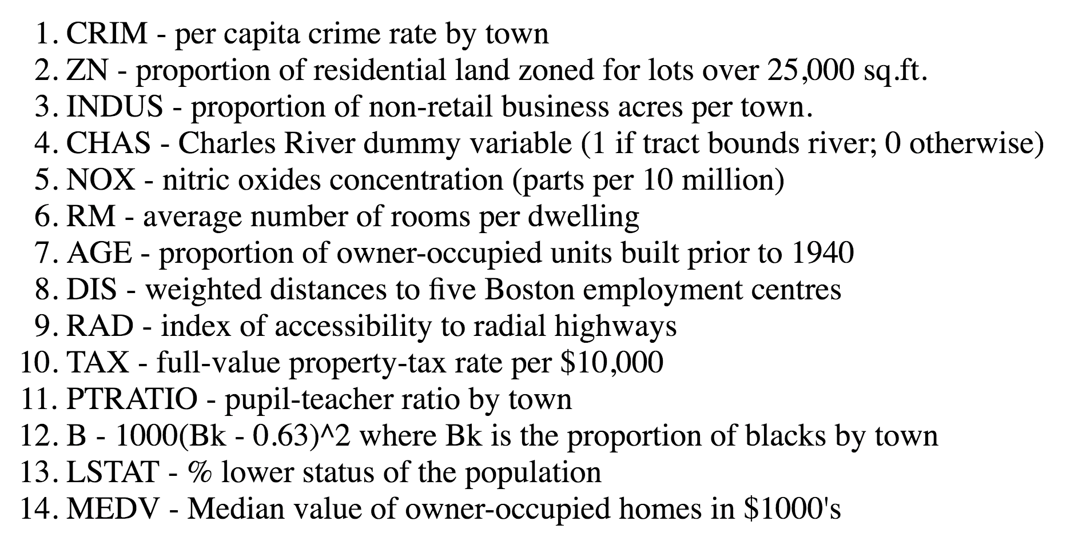
Target:
House Value

Slide 6
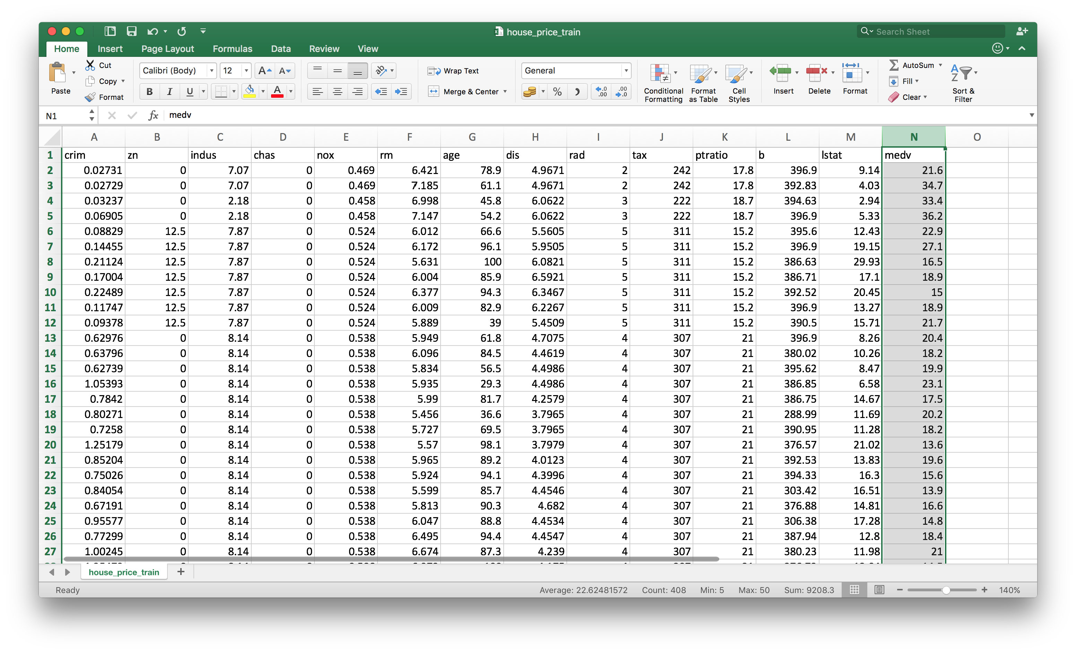
../..regression/
house_price_train.csv

Slide 7
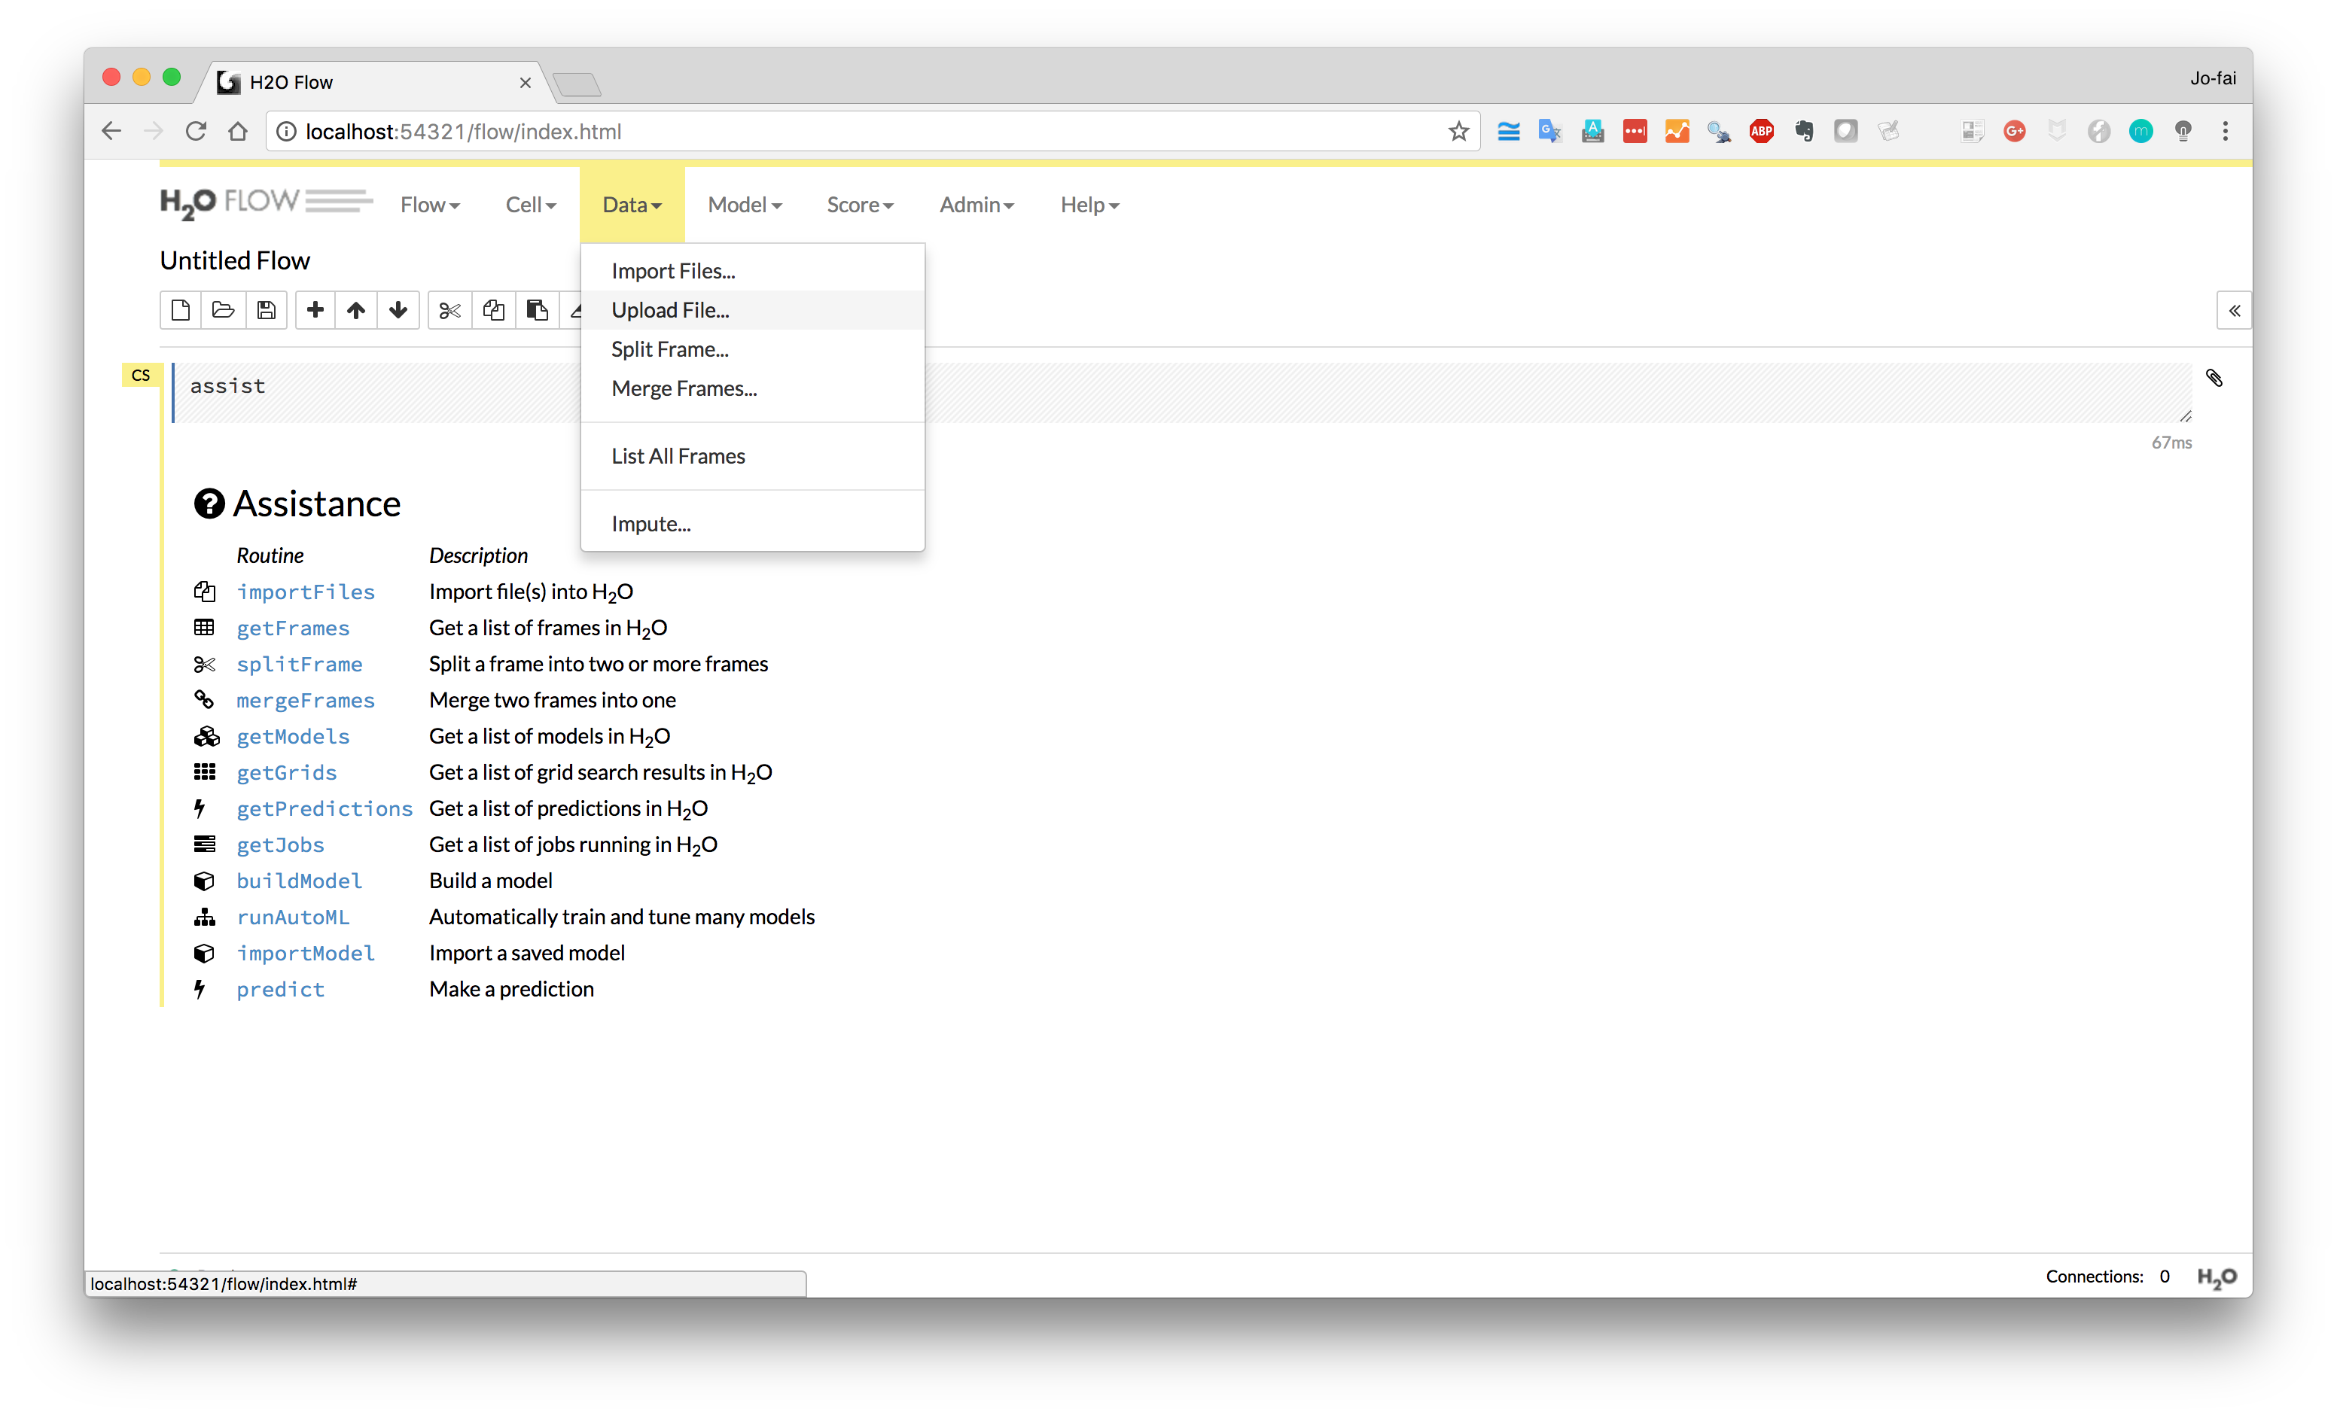
Data → Upload File …

Slide 8
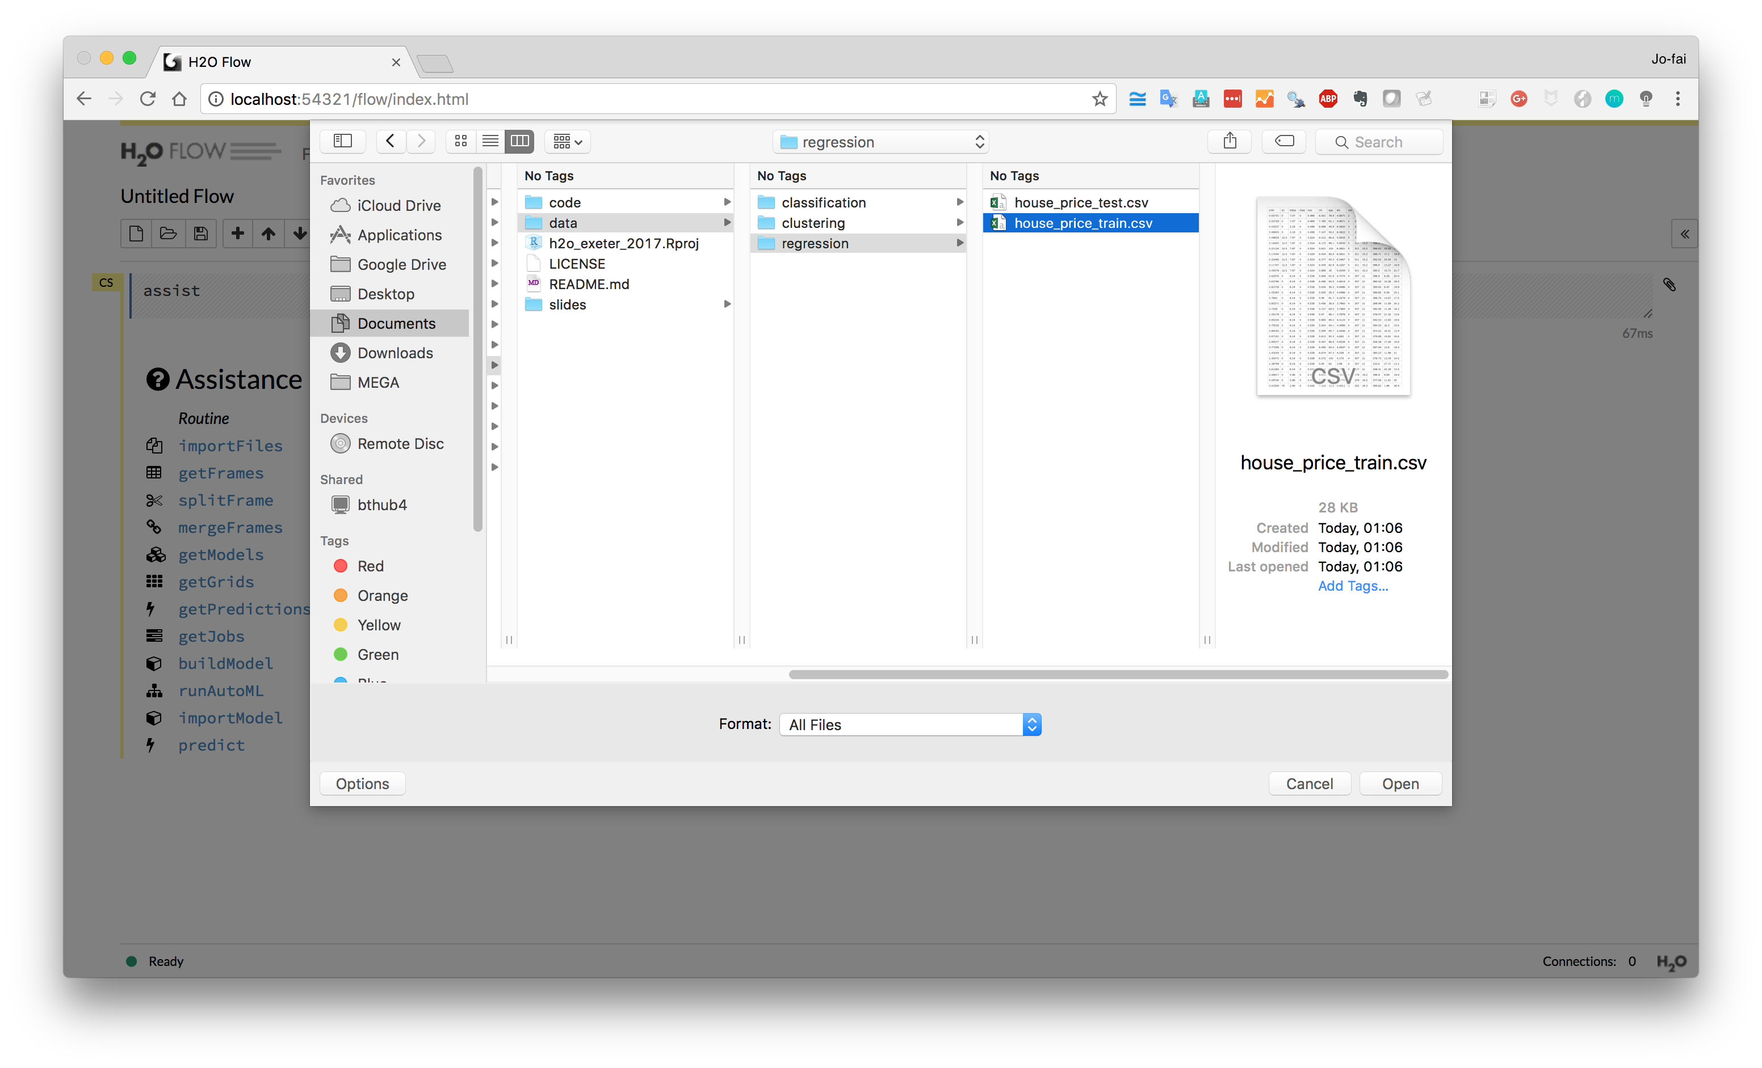

Slide 9
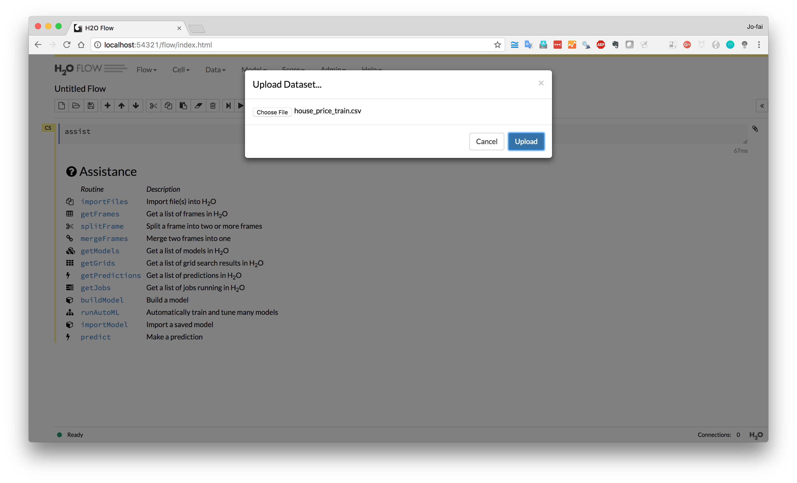
Upload

Slide 10
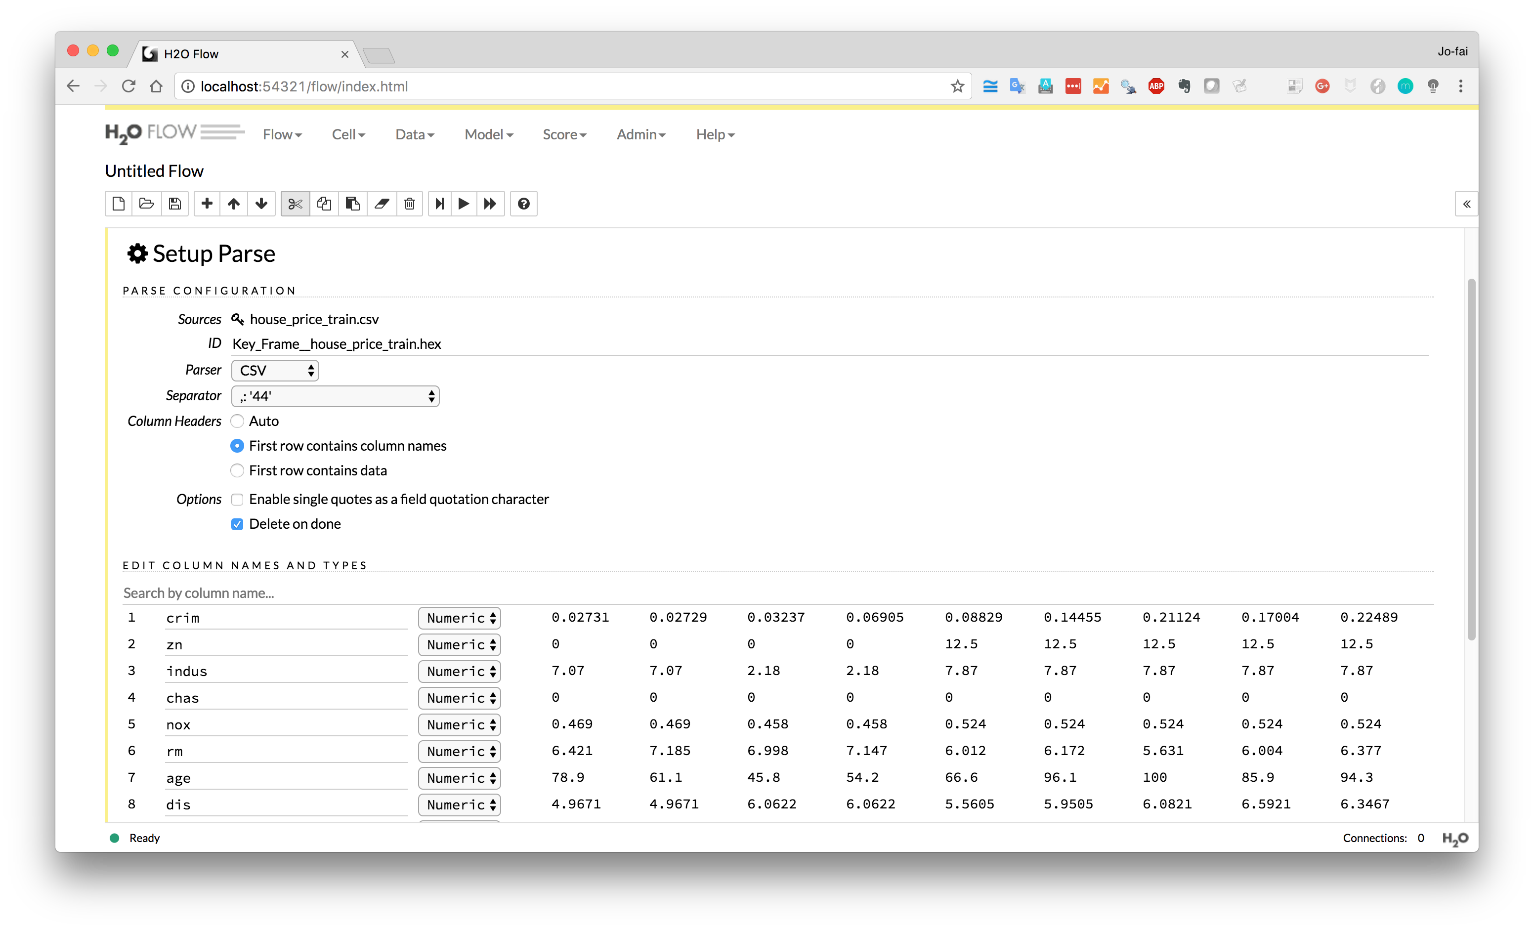
Scroll down

Slide 11
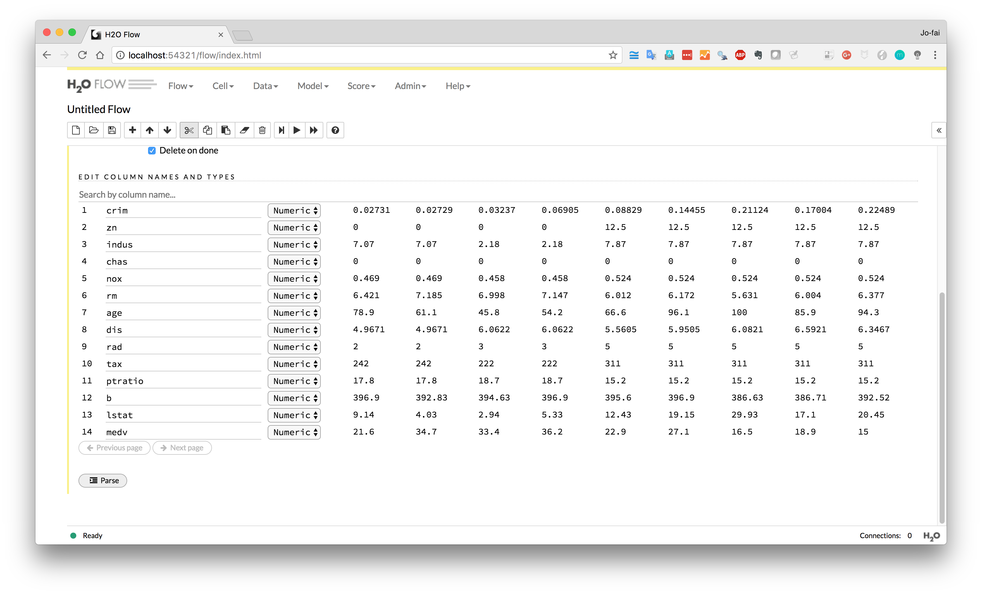
Click ”Parse”

Slide 12
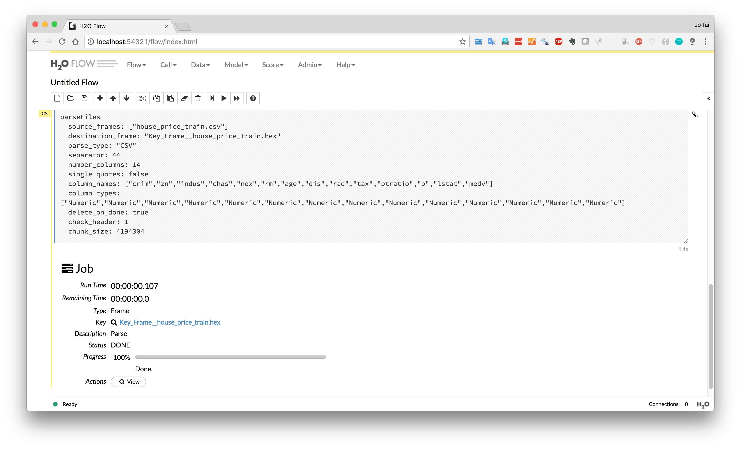
Click “View”

Slide 13
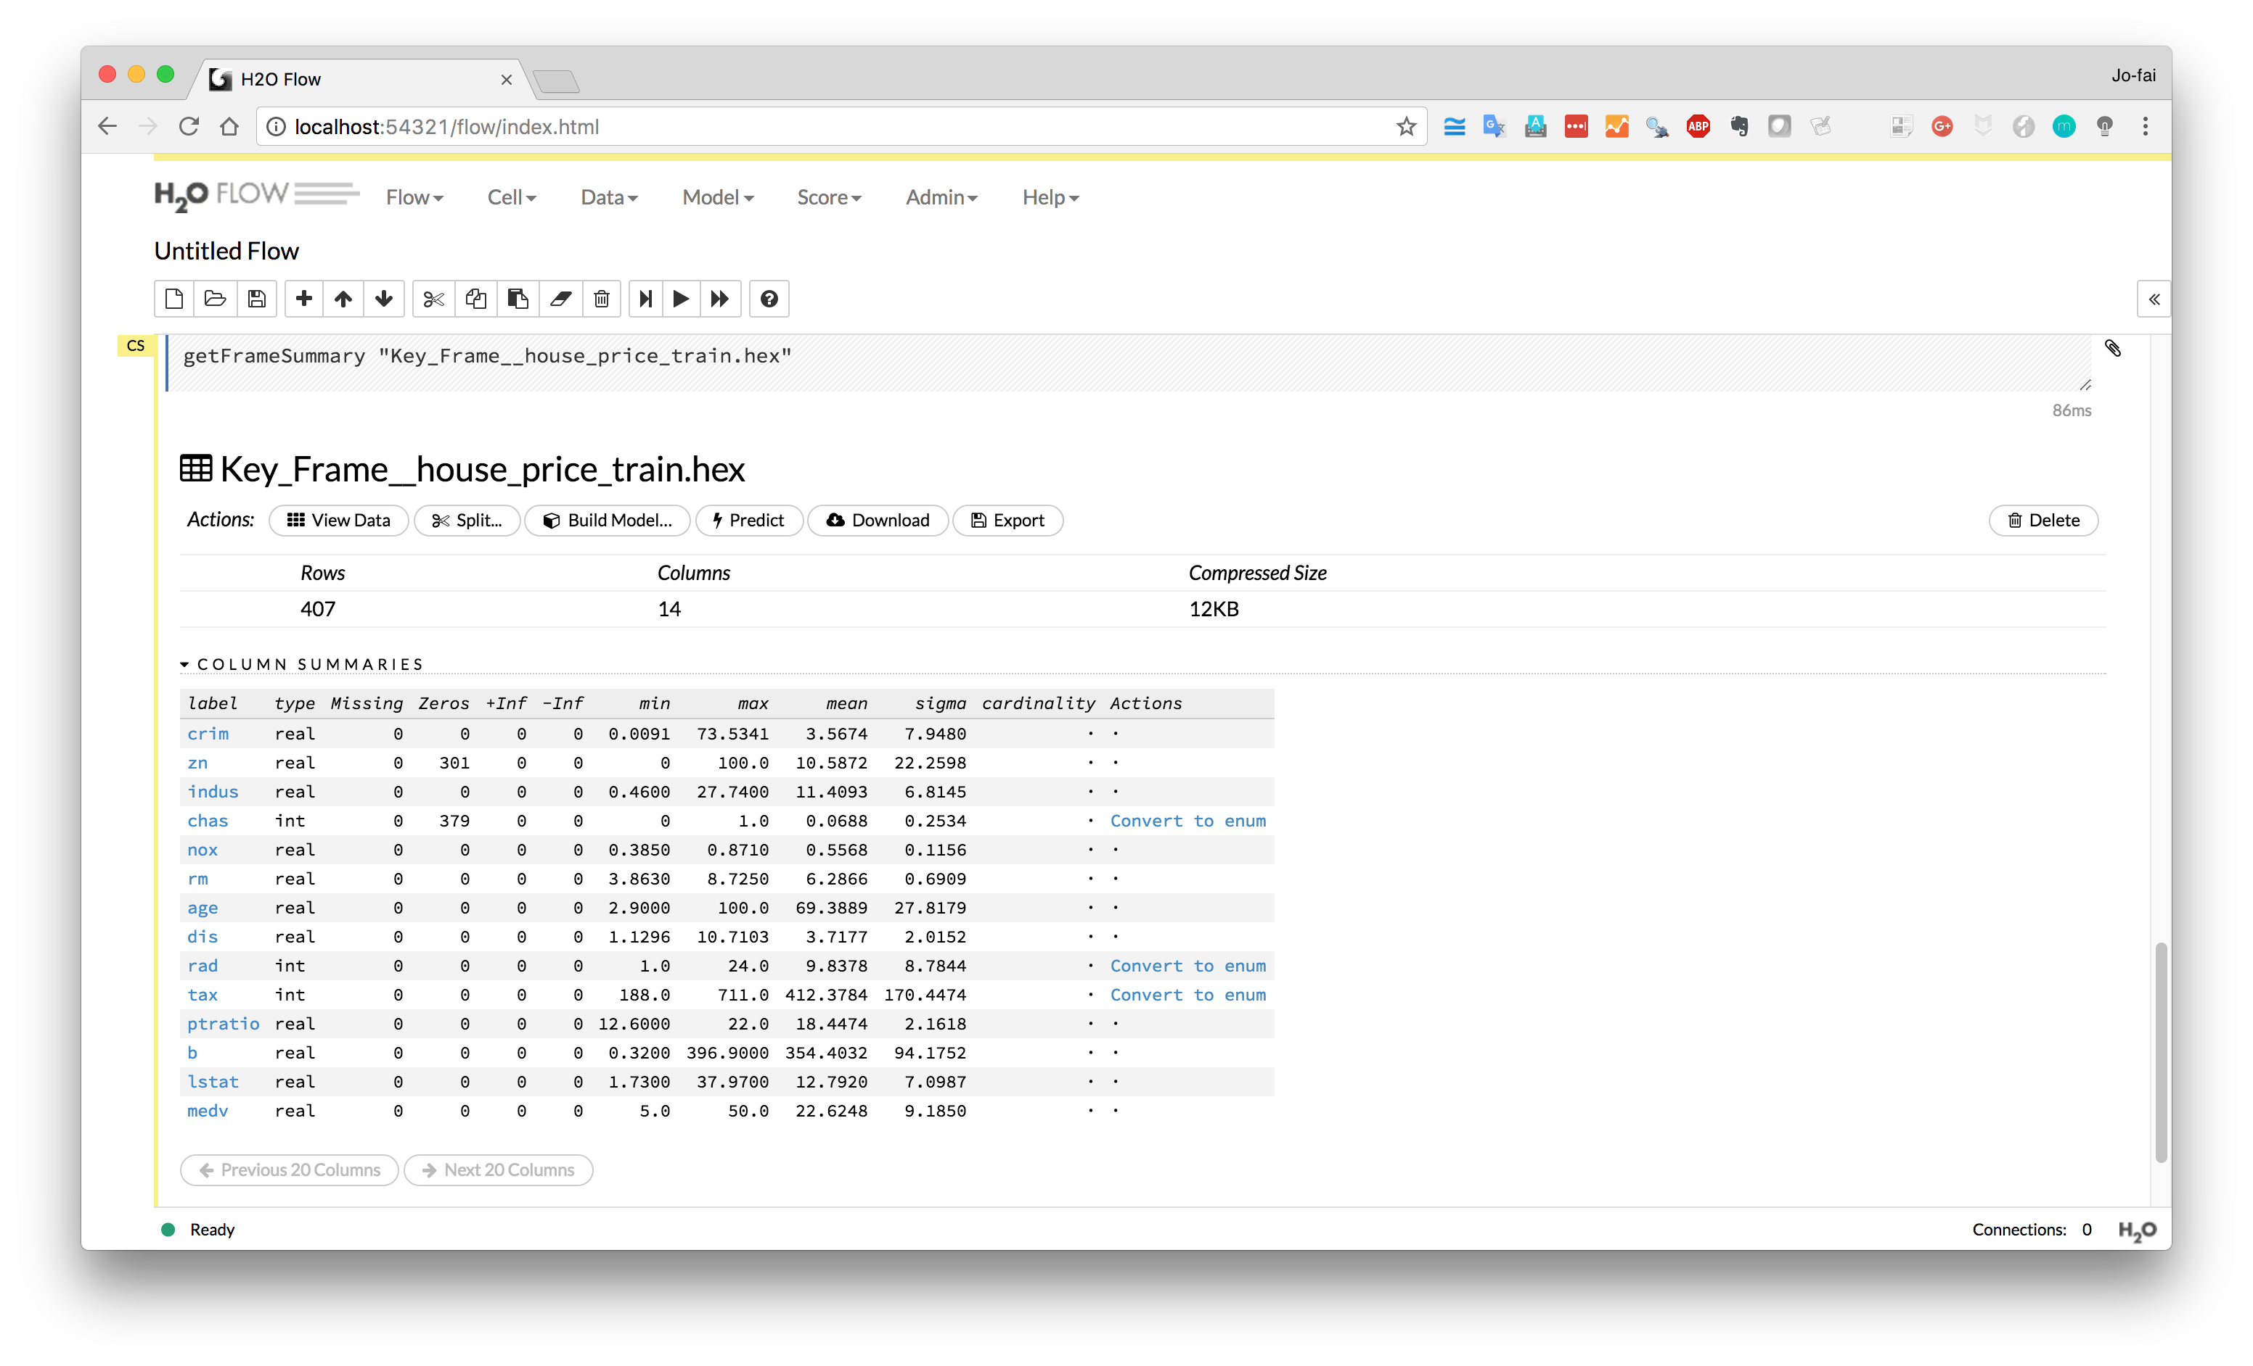
Click on any variable
e.g. crim, medv

Slide 14
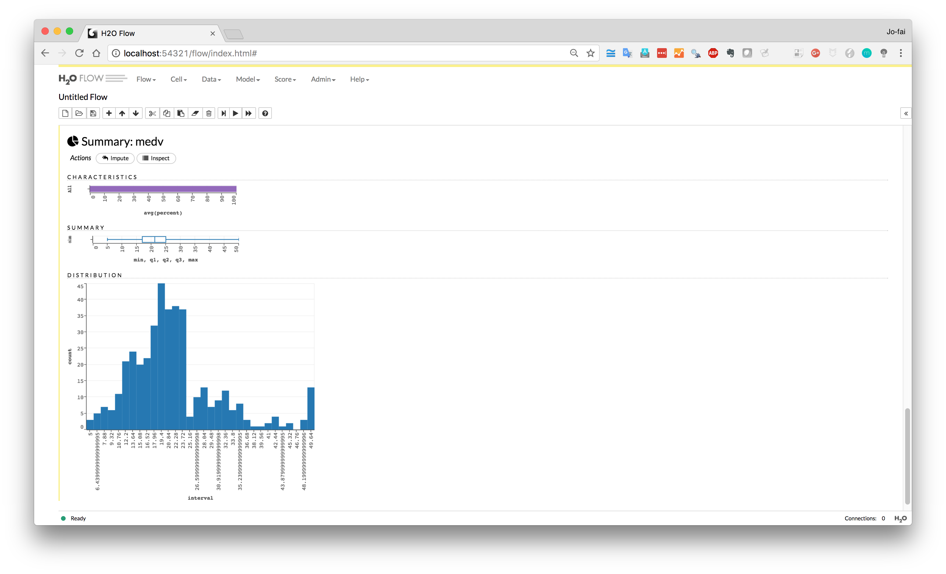
Some basic visualisation for
quick exploratory analysis

Slide 15
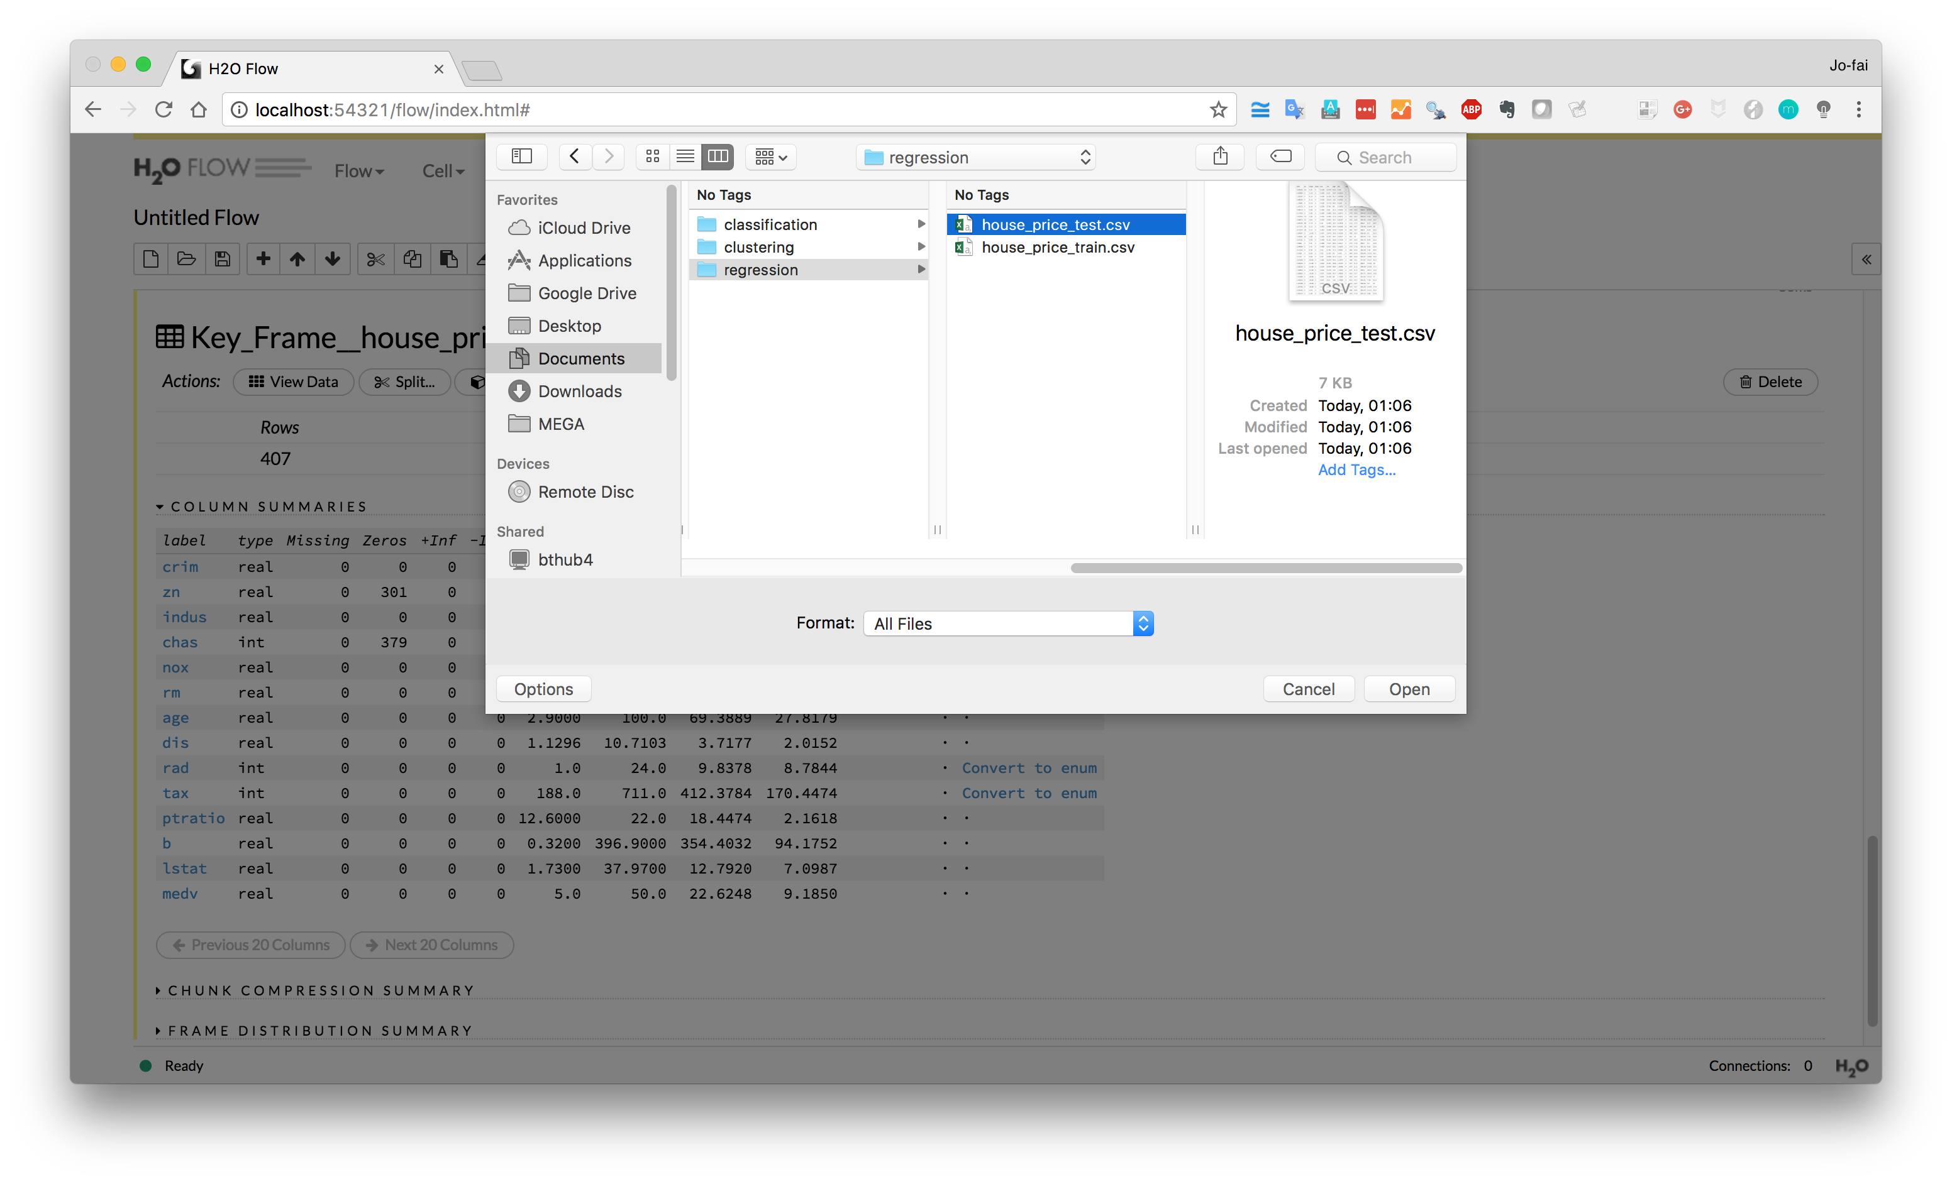
Now do the same for
house_price_test.csv
(e.g. new data for making predictions)

Slide 16
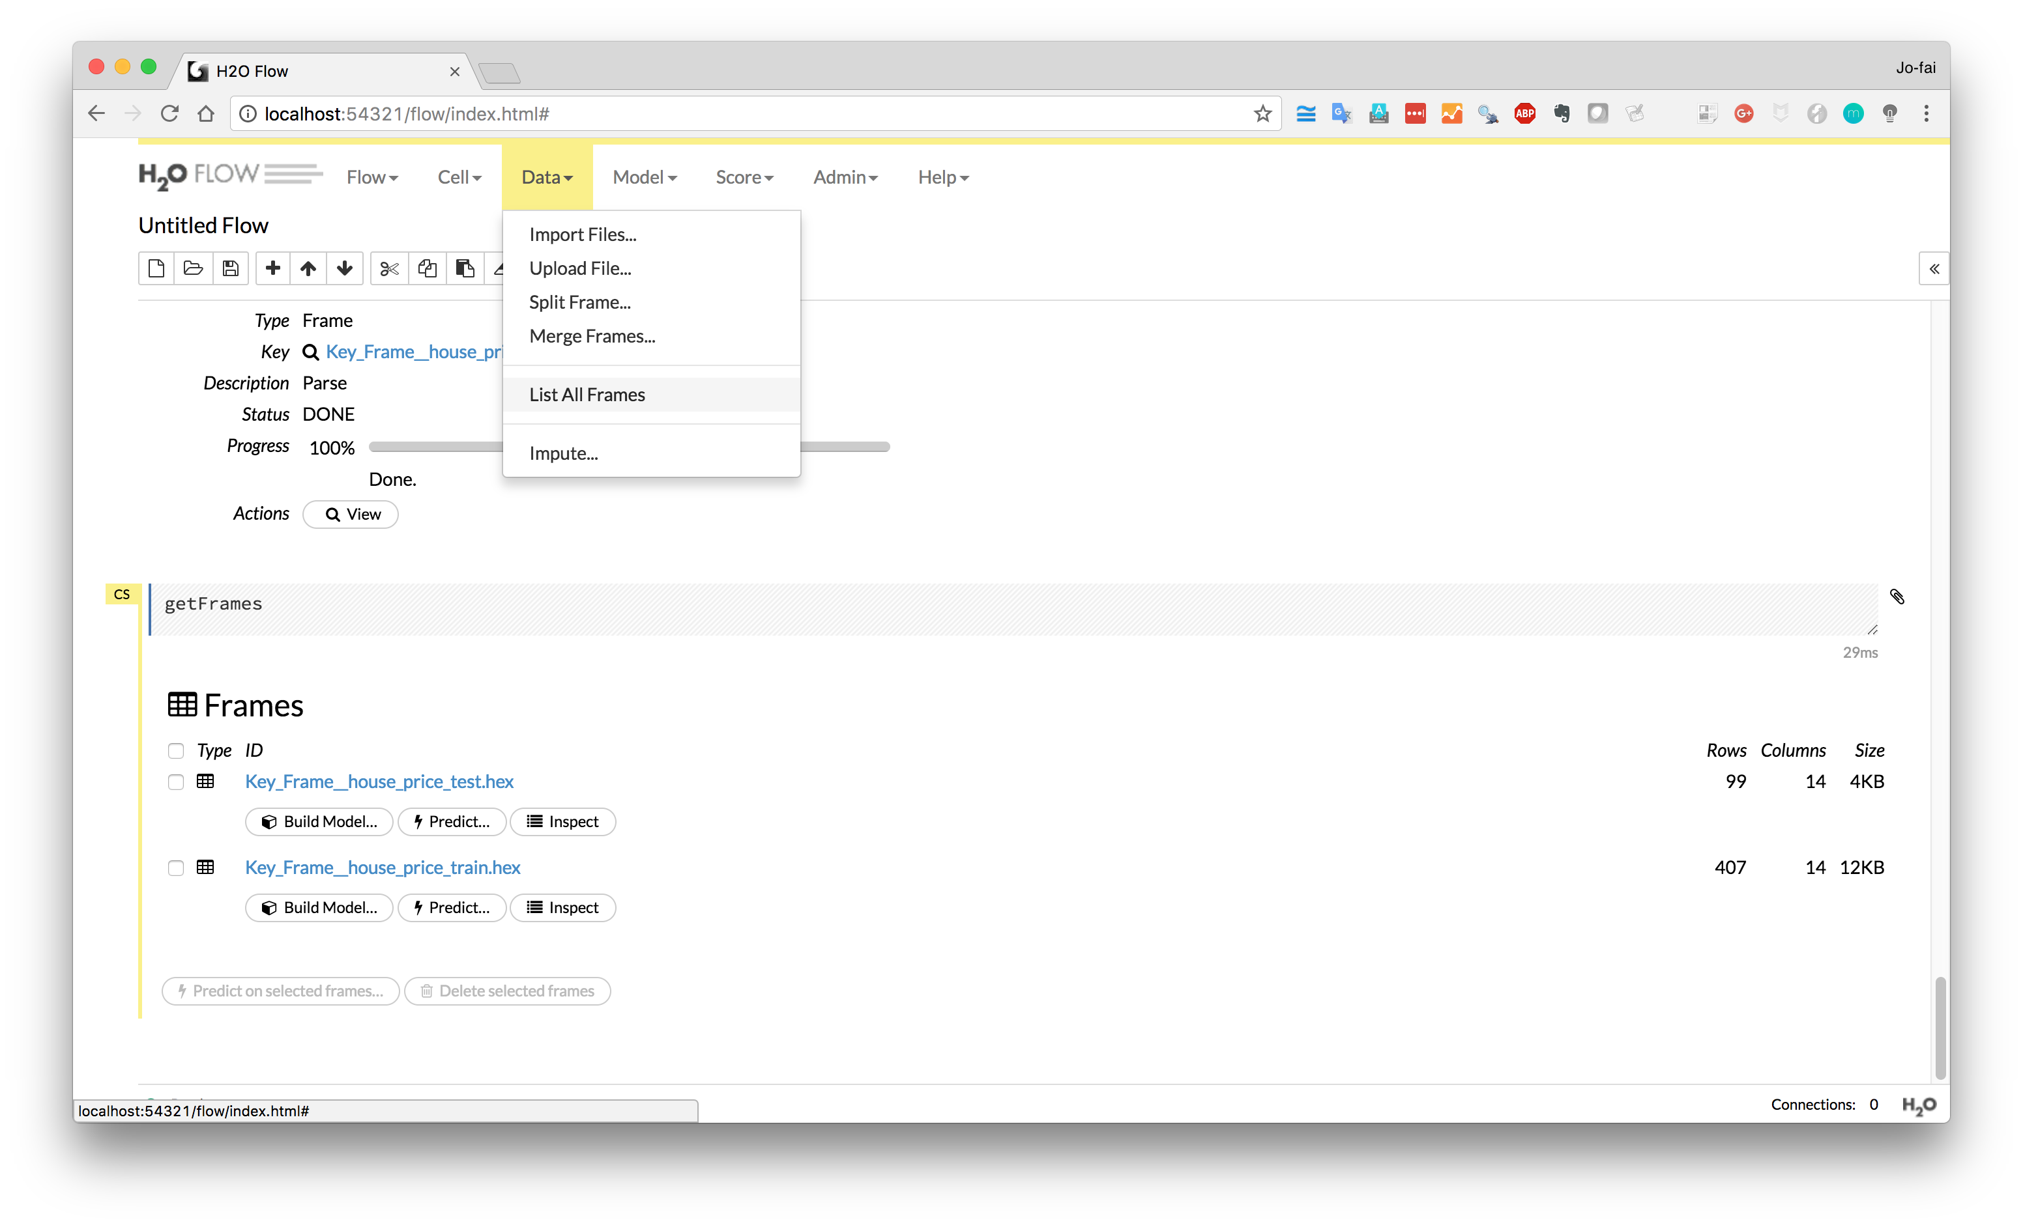
Show all data
Data → List All Frames

Slide 17
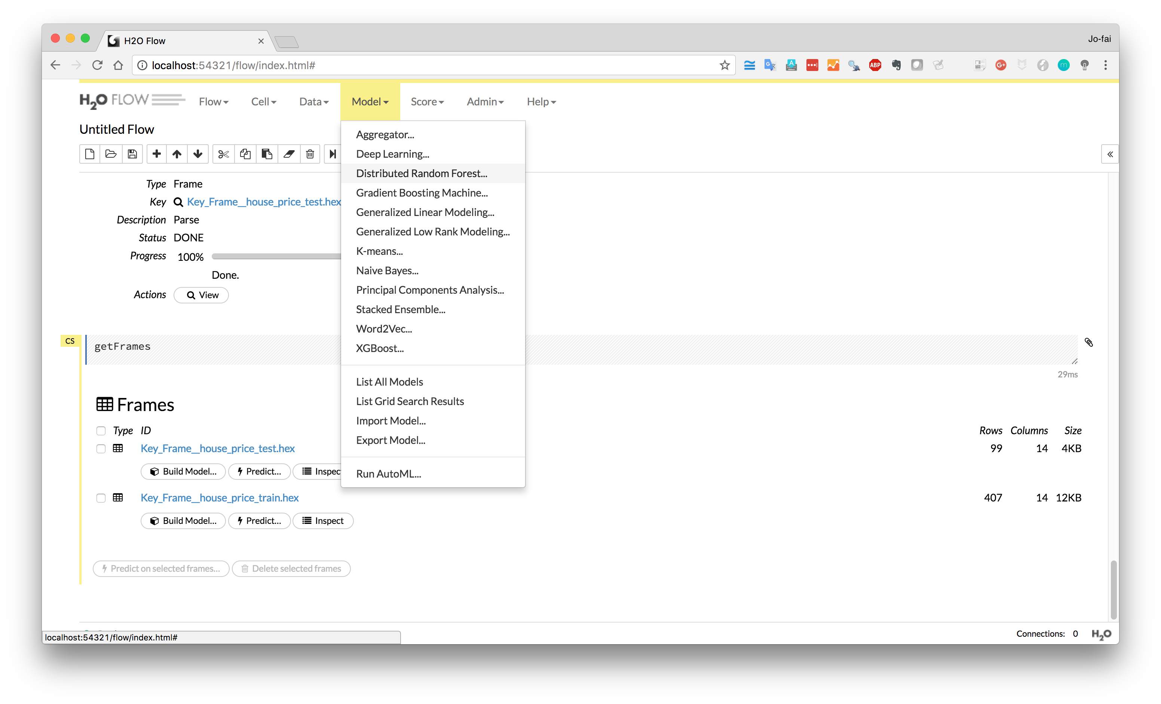
Train a predictive model
Start with Random Forest

Slide 18
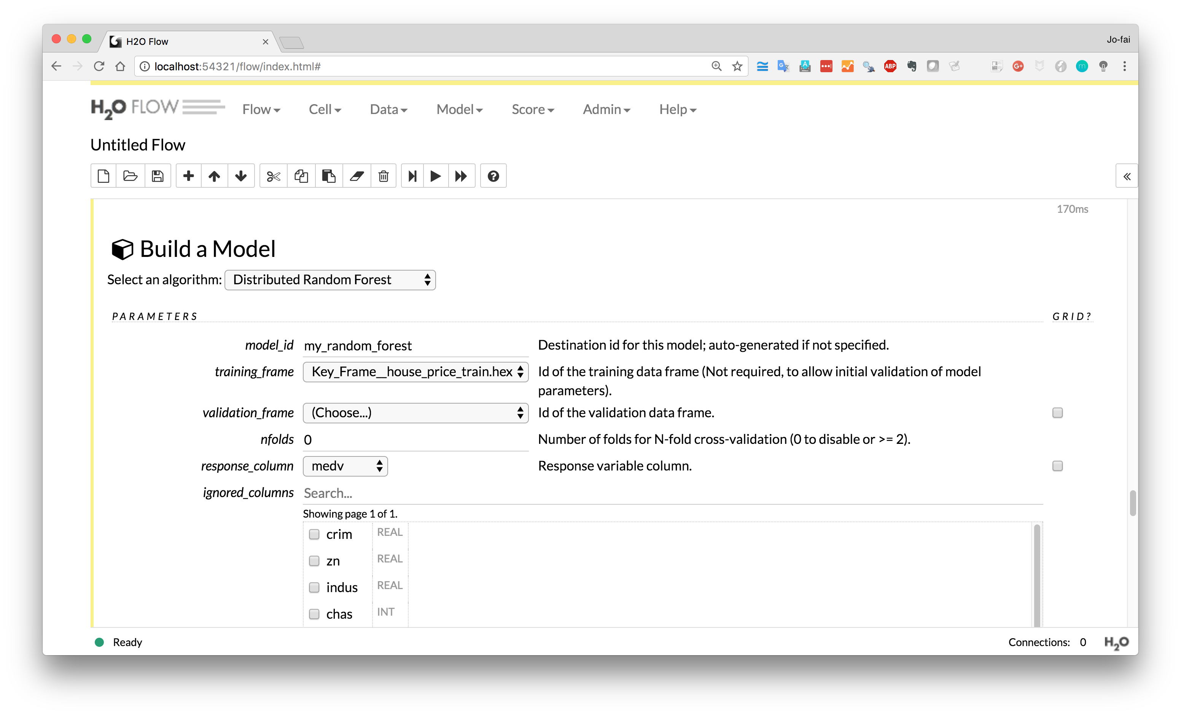
1) Choose “house_price_train”
2) Select “medv” as response

Slide 19
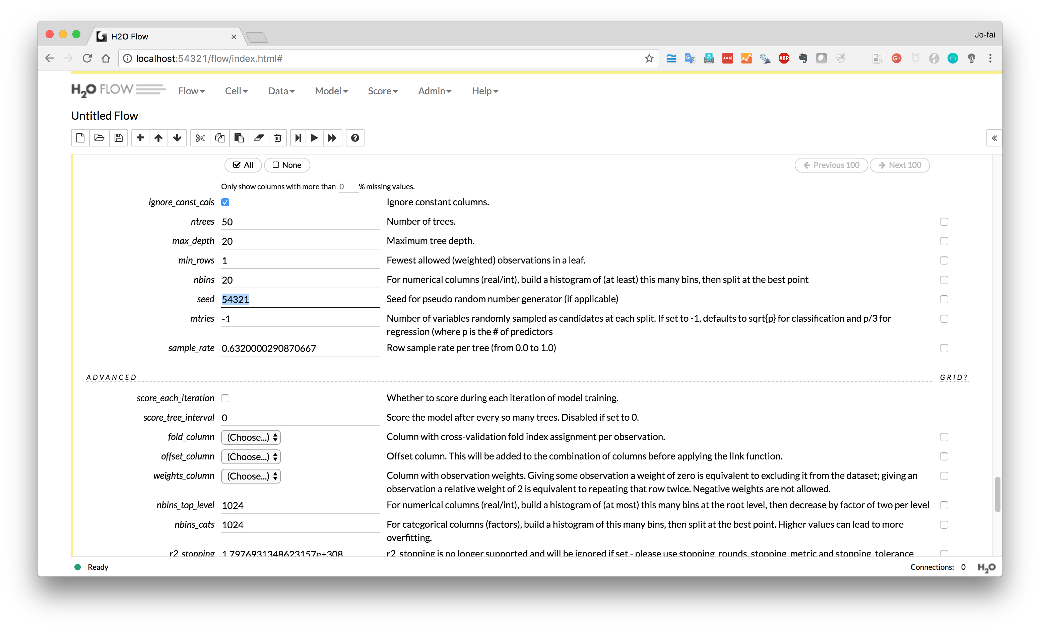
Enter a seed number
(if you want to reproduce your results in future)

Slide 20
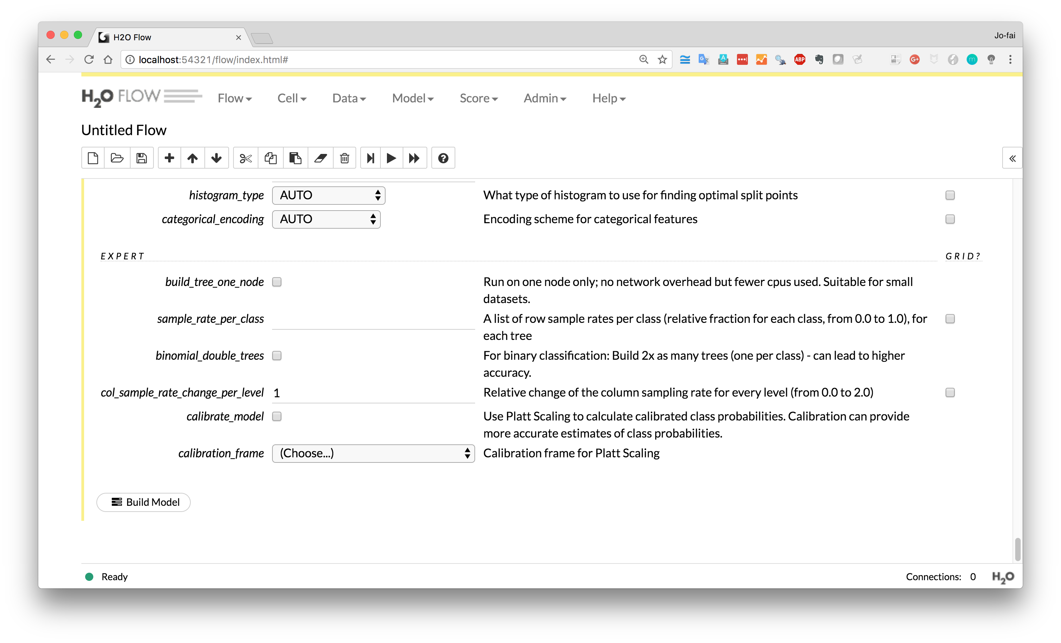
Scroll down and click
“Build Model”

Slide 21
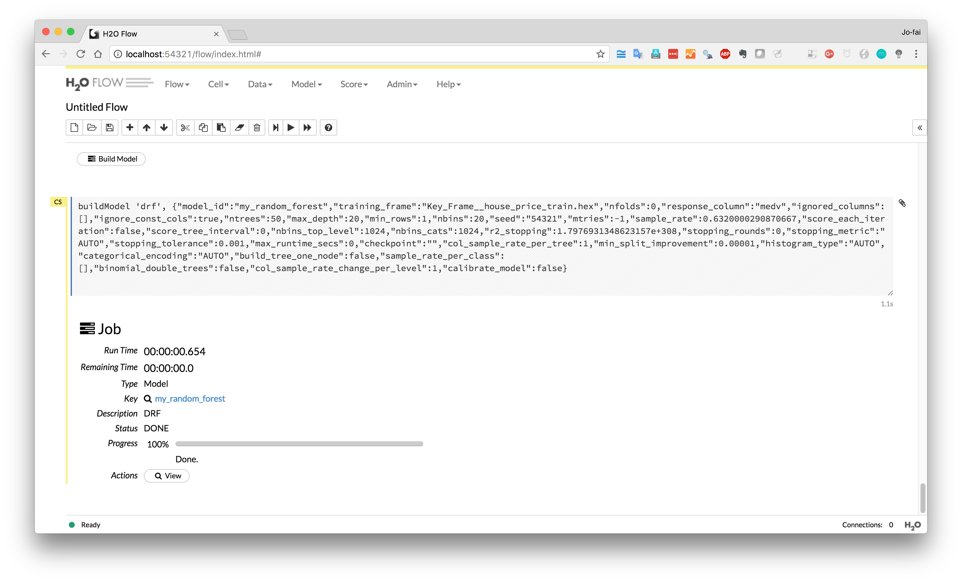
View the model

Slide 22
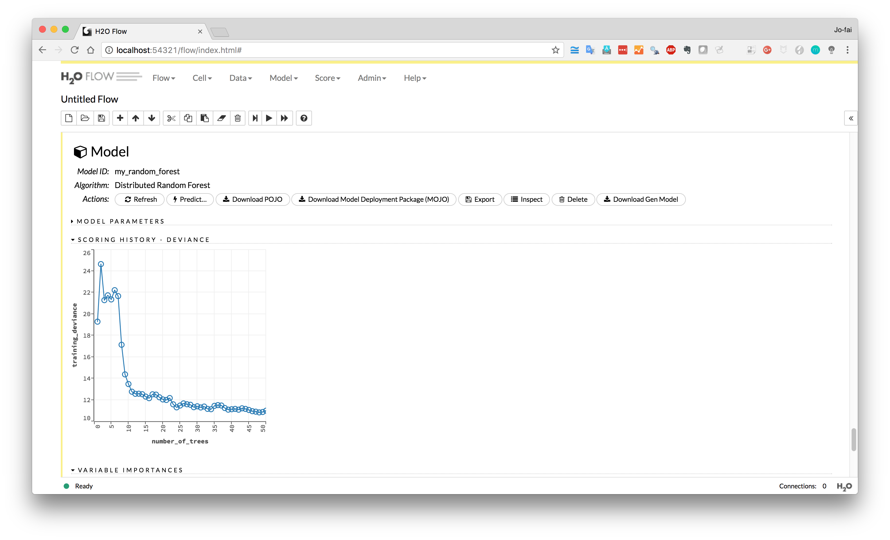
Performance metric
Deviance
(Mean Squared Error)

Slide 23
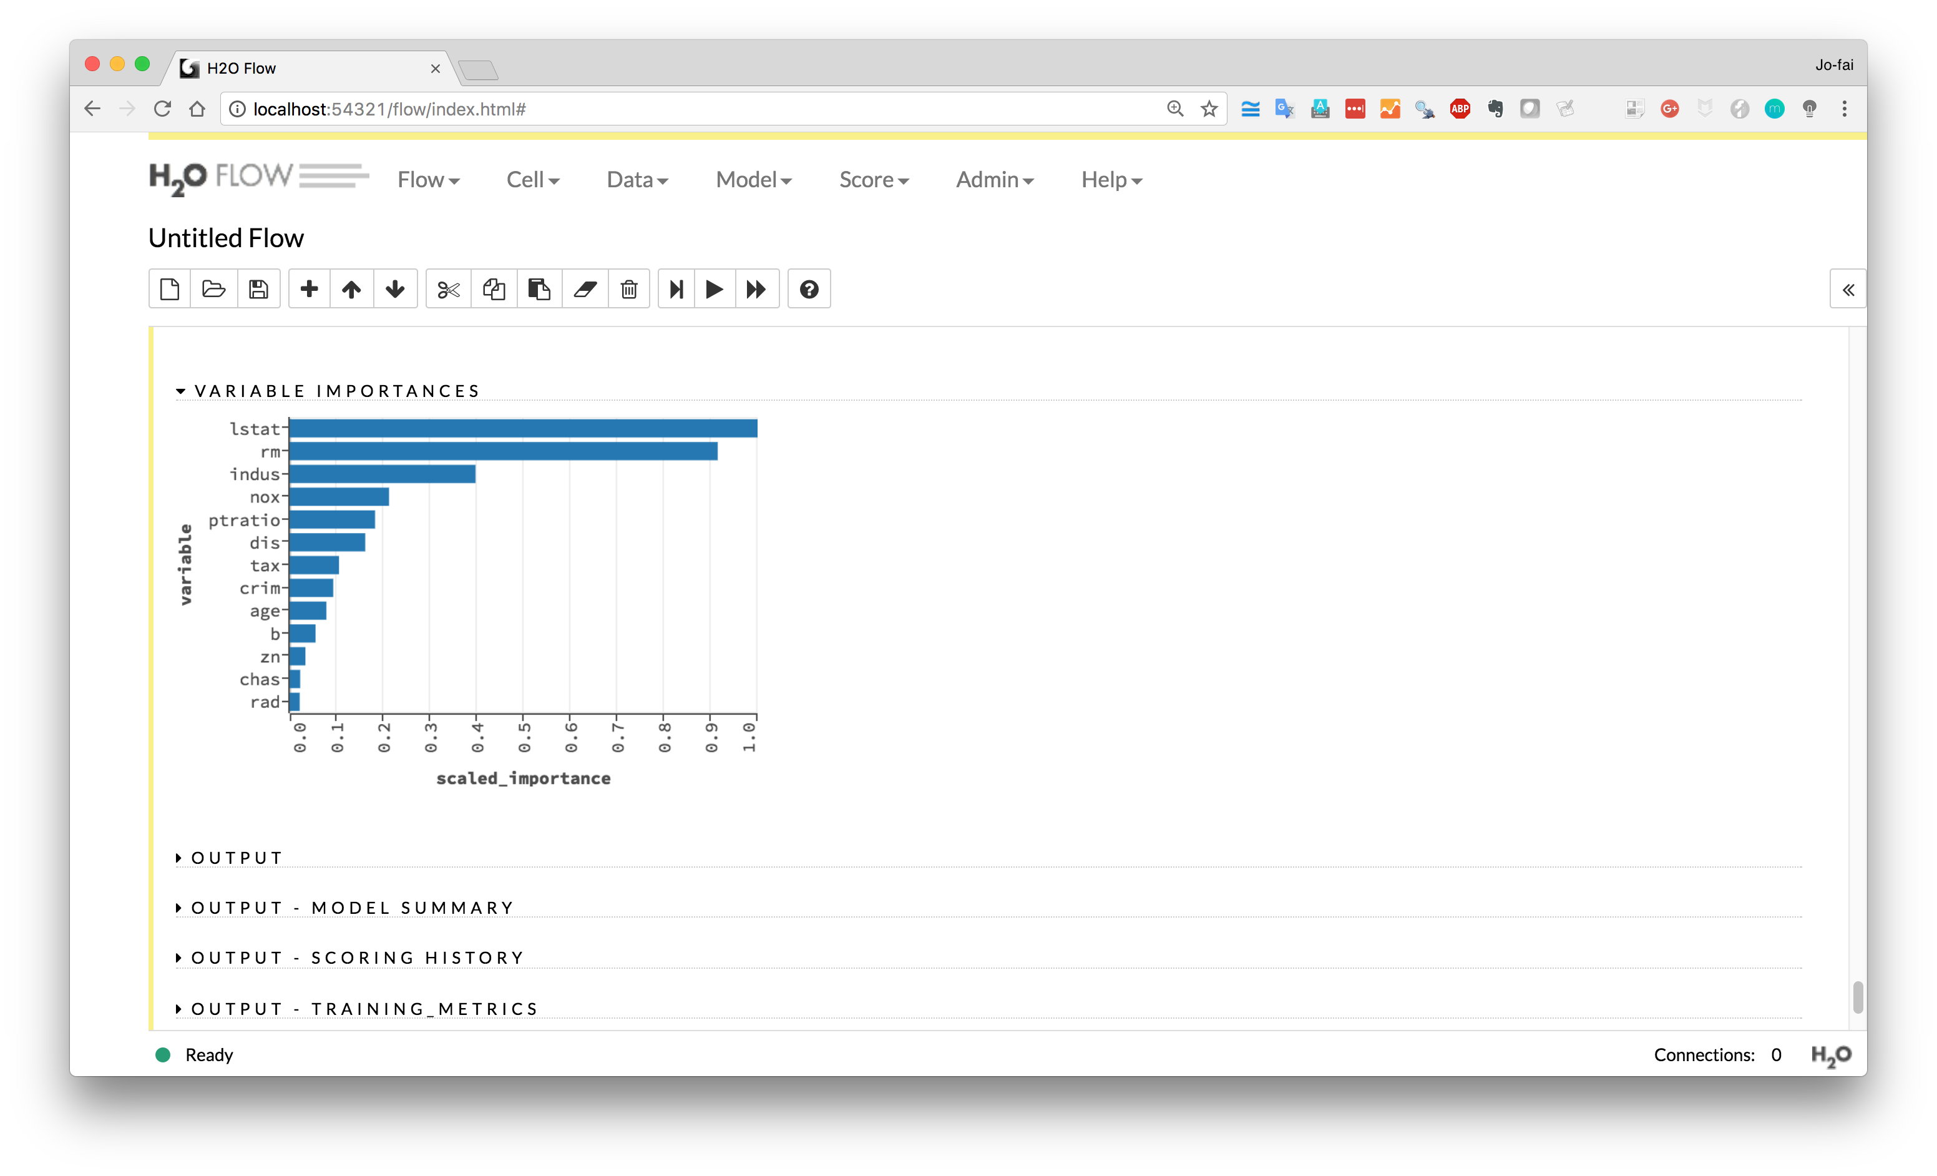
Variable Importance
(it tell you which variables are the key factors)

Slide 24
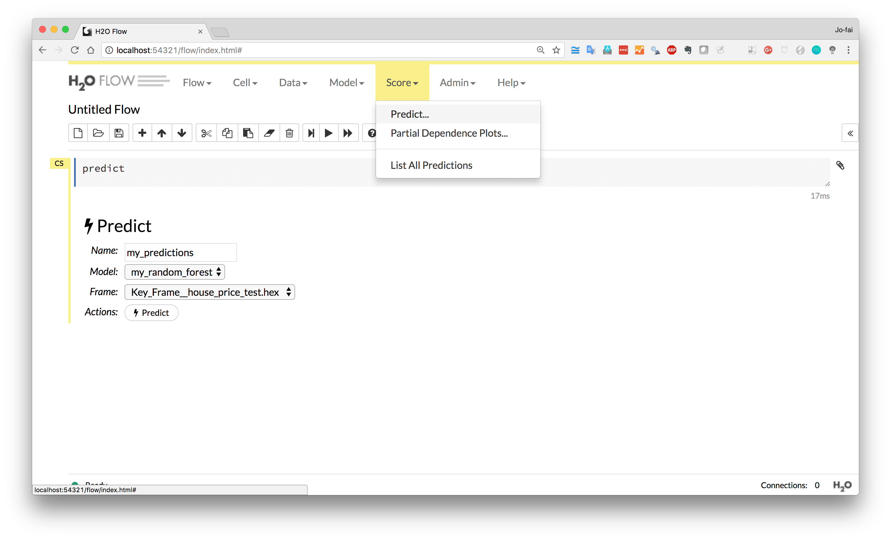
We have a model.
We can now make some predictions on the test dataset.
Score → Predict
Select the model
Select “test” data
Click “Predict”

Slide 25
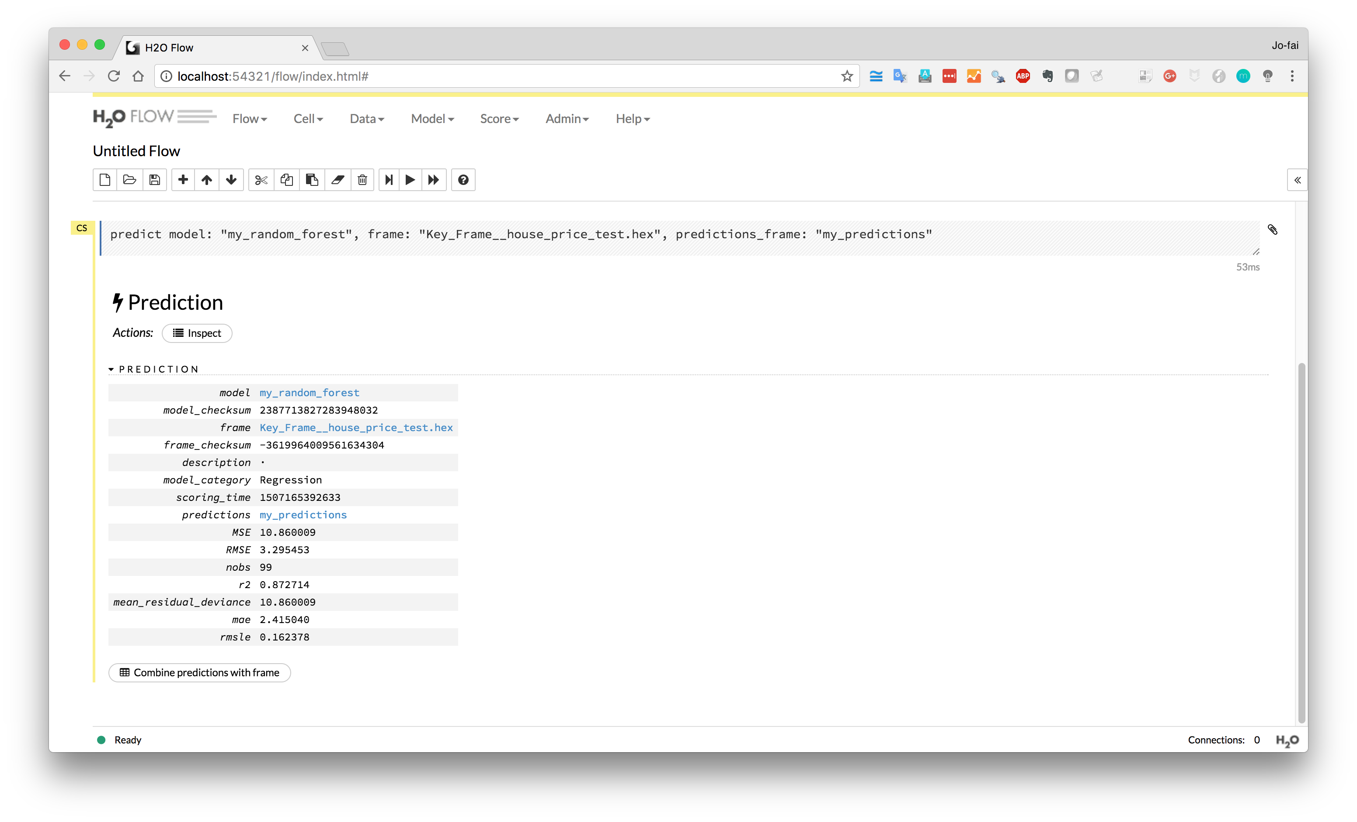
Combine predictions with original test data so we can compare the predictions with ground truth.

Slide 26
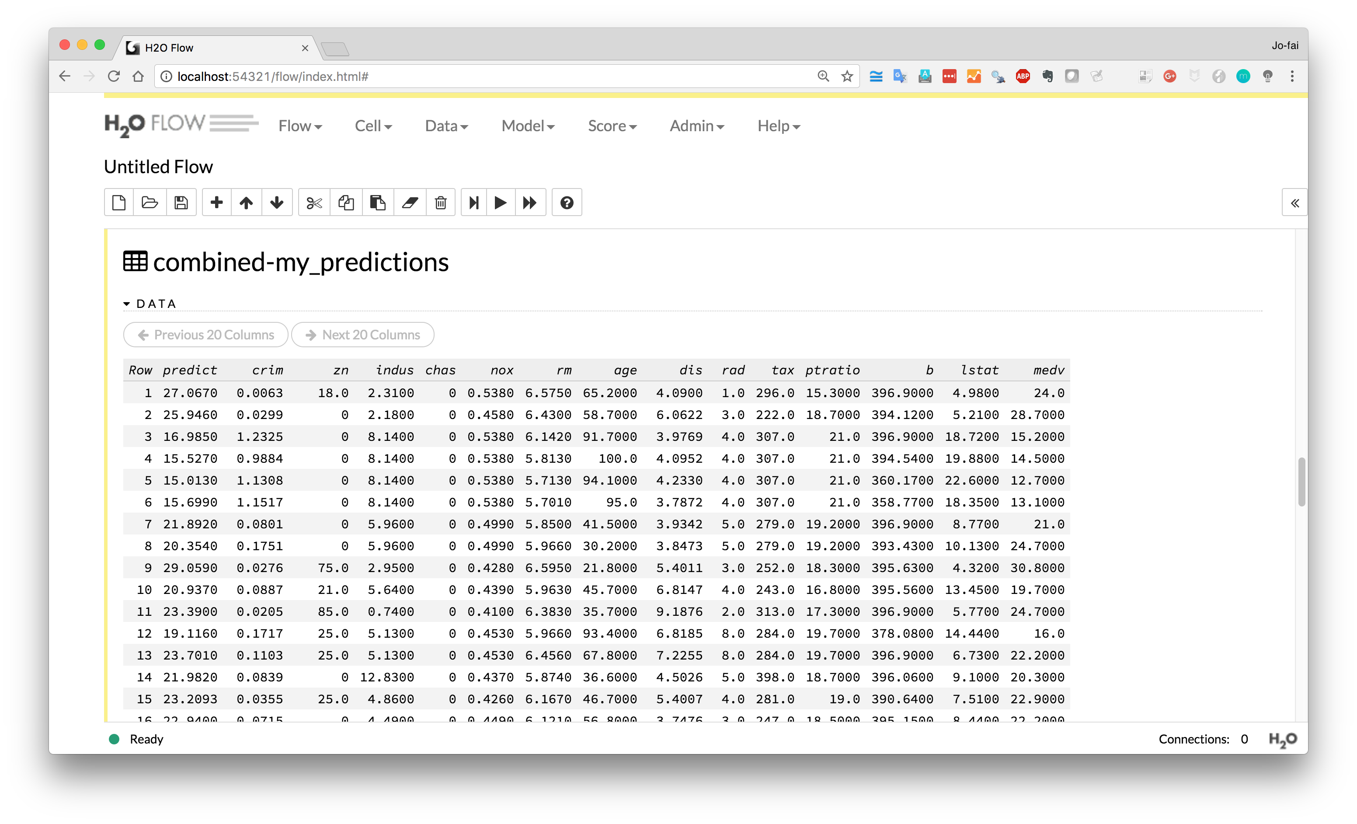
Prediction
Ground Truth

Slide 27
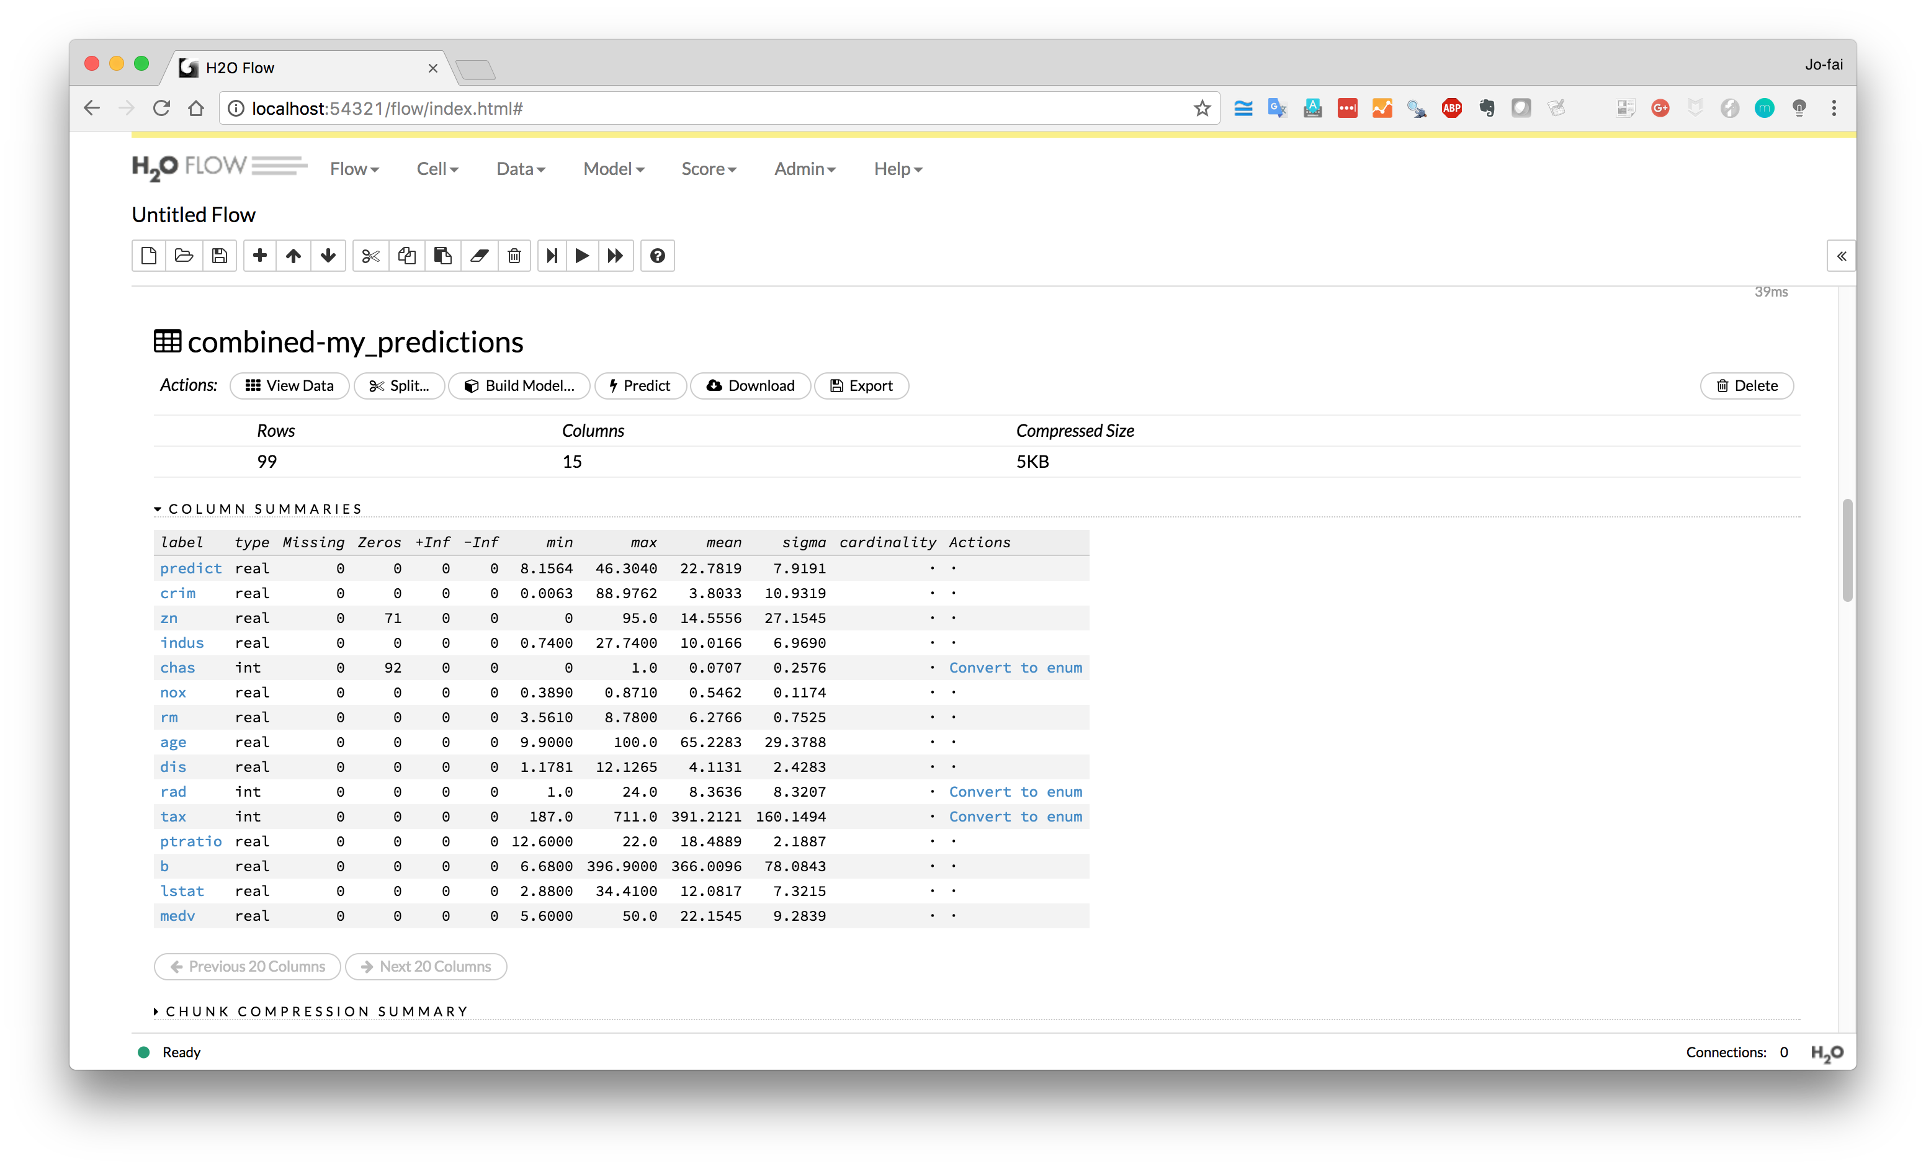
Download the results

Slide 28
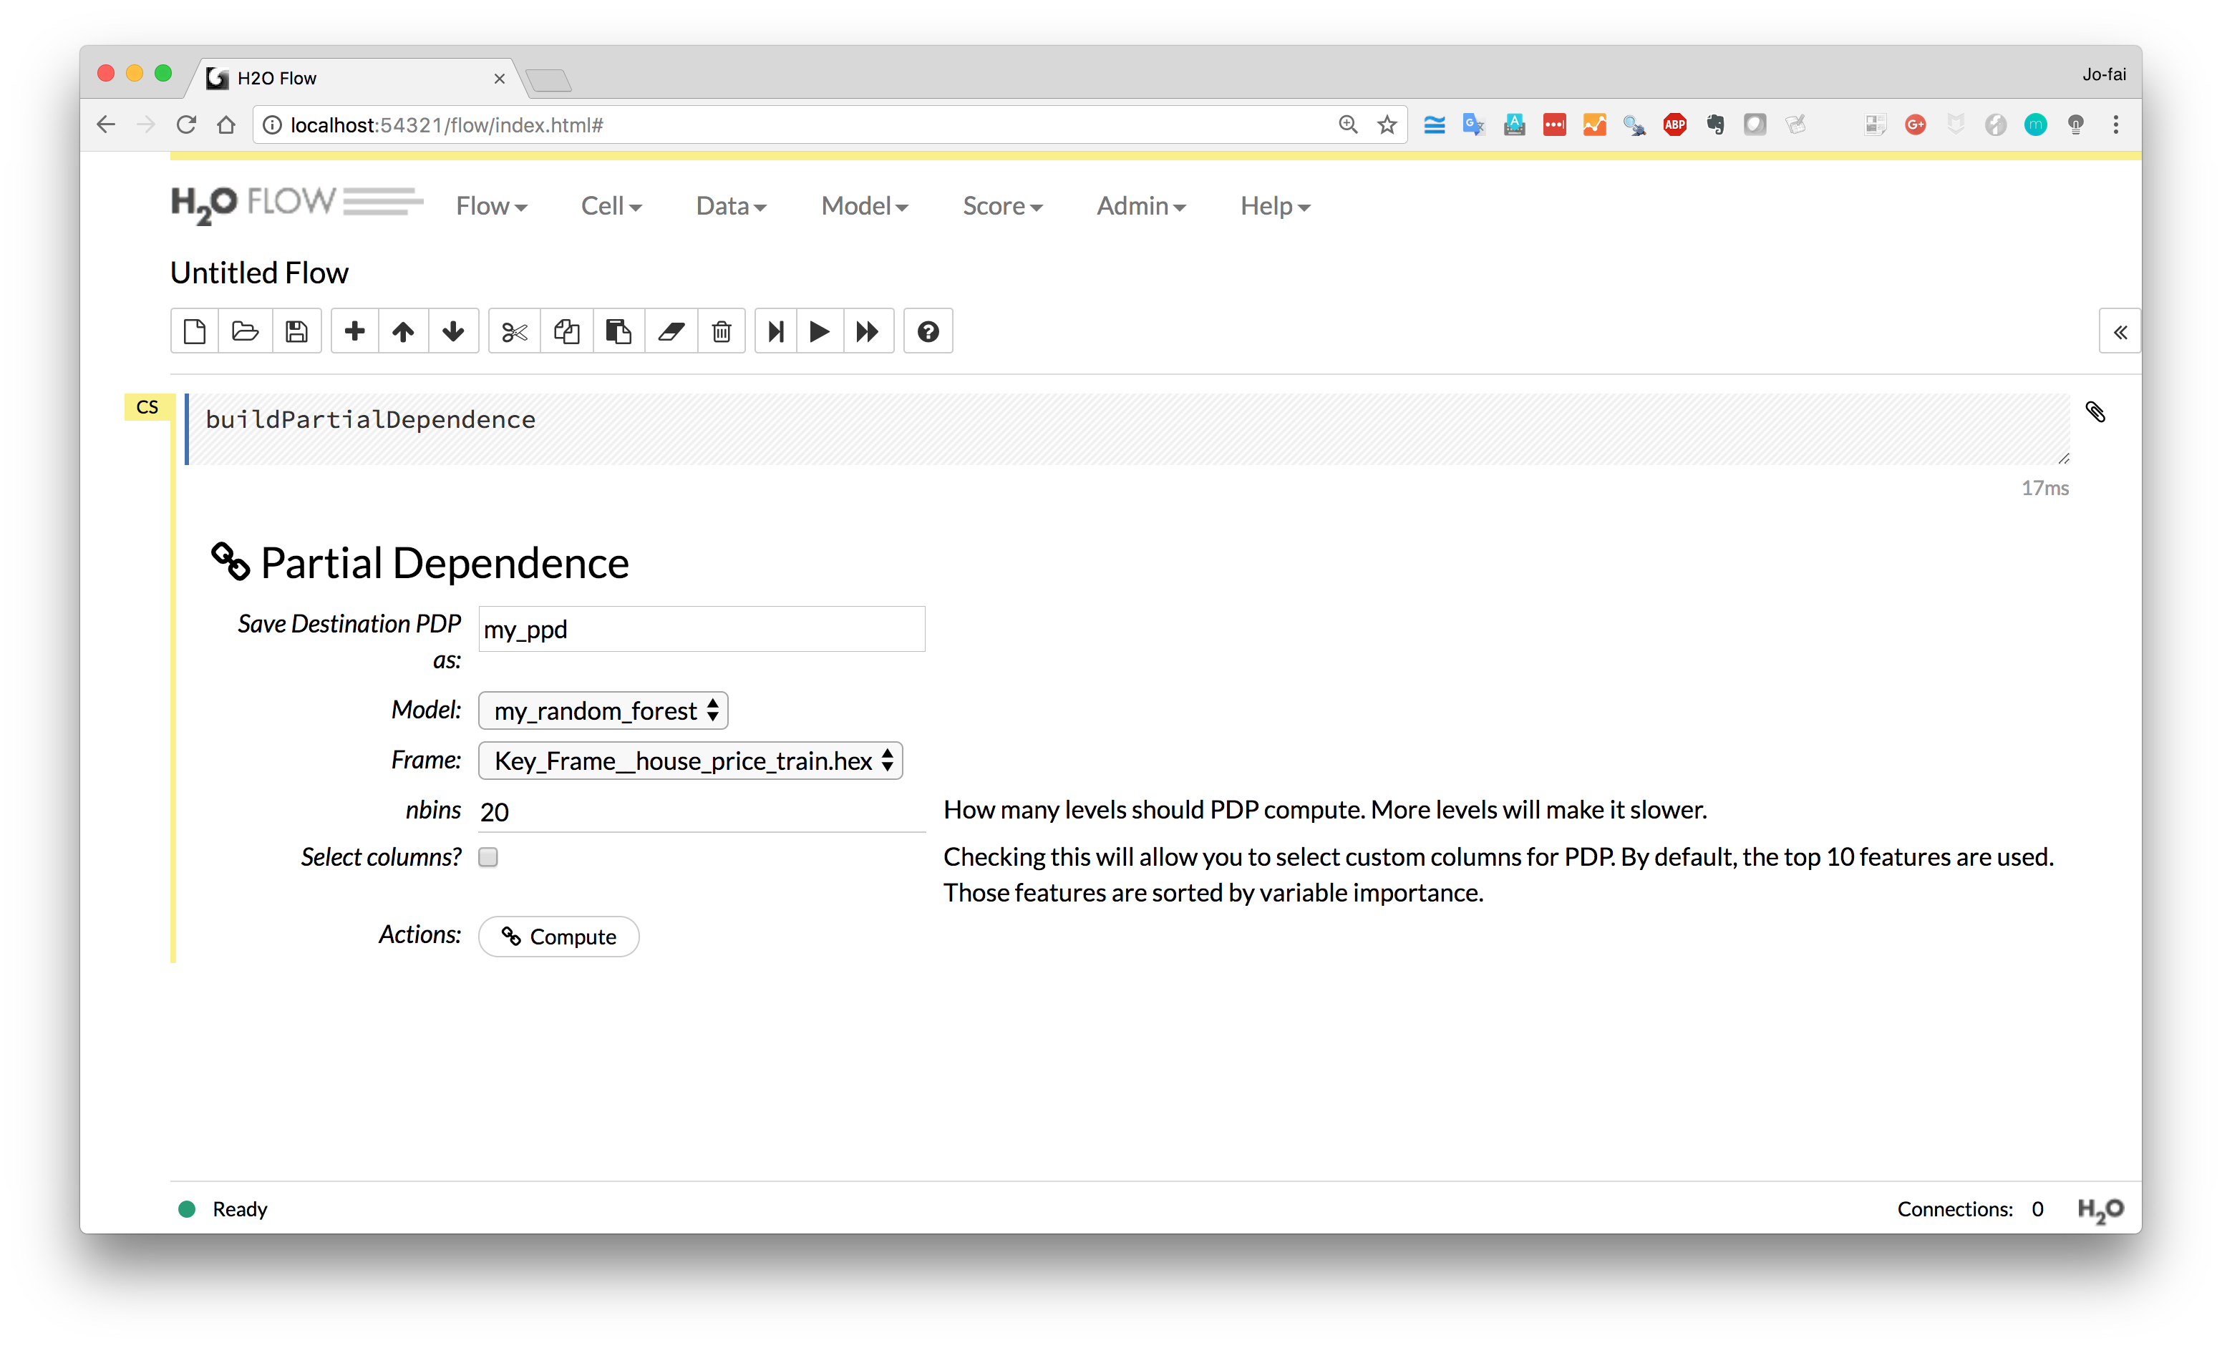
Using Partial Dependence Plots to further explain results

Slide 29
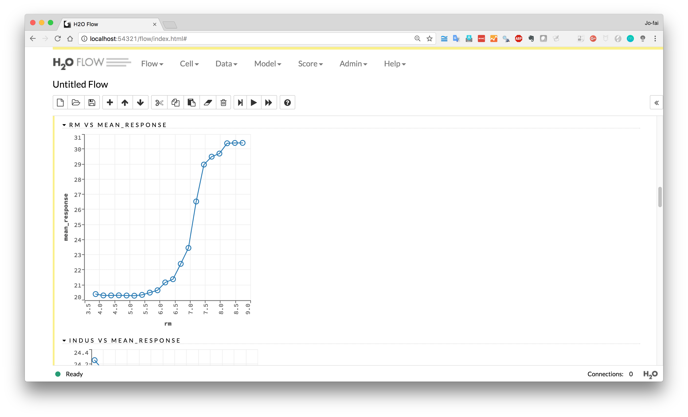
More rooms = higher house value

Slide 30
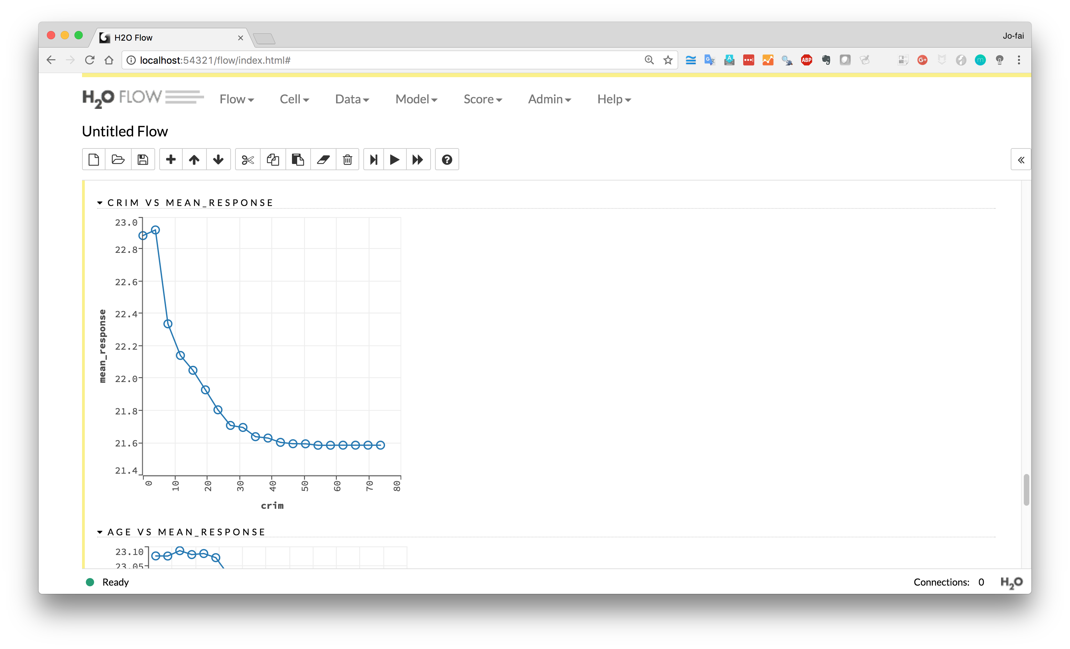
Lower crime rate
= higher house value

